Slide 1



Introduction to TensorFlow + Keras
EngHack 2021 Workshop
Andrew Shao

Slide 2

Andrew Shao
Your photo
Grade 11 Student at St. Aloysius. Gonzaga. Secondary
Deep Learning Practitioner, Proficient in TensorFlow, Keras, and PyTorch
Placed 29th in the World on the Kaggle HuBMaP Kidney segmentation challenge
https://www.linkedin.com/in/andrew-shao-7653591b4/
https://github.com/ShaoA182739081729371028392

Slide 3
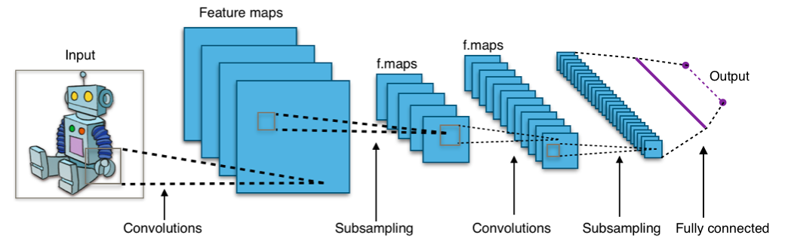
Schedule:
A Primer on Neural Networks and Deep Learning
Optimizers and How Machines Learn
What is TensorFlow?
TensorFlow vs PyTorch: Pros and Cons
Parts of the Machine/Deep Learning Workflow(5 Step Cycle)
TensorFlow Syntax and Best Practices: 3 Parts
Data Pipelines with Tf.Data
Neural Network Building
Training and Model.fit
Interactive Demonstration: Training a Model on CIFAR-10 using TensorFlow and Keras

Slide 4
Part One: A Primer on Deep Learning

Slide 5
What is Deep Learning?
The Machine Learning Taxonomy(Greatly Simplified):
Explicit Algorithms:
Hard-Coded
Never Changes
Machine Learning(Scikit-Learn, etc.)
Adapts a little
Simpler Models
Understandable and Visualizable
Deep Learning(PyTorch, TensorFlow, Paddle-Paddle):
Complex
“Black-Box”
Deep Learning
1
Machine Learning
2
Algorithms
3
Notes:
Deep Learning is a Subset of Machine Learning, which is a subset of Algorithms
Explicit Algorithms:
Code what you want it to do
If the code is error-free, it always will be(It never changes)
Machine Learning(Scikit-Learn, etc.)
Dedicated Algorithm that adapts with Data
You can still largely control most of the learning, as models are simple with little weights(Ex. Linear Regression, Decision Trees, Adaboost)
Understanding the model is relatively simple
Deep Learning(PyTorch, TensorFlow, Paddle-Paddle):
Model is much more complex(Convolutional Neural Networks, MLP’s, RNN’s)
Black-Box algorithm, we program the initial model and training method, but after training, we have no idea what the model has learned(Too many weights to keep track of)
Typically much more powerful(Most Human-Like AI is Deep Learning Based)

Slide 6
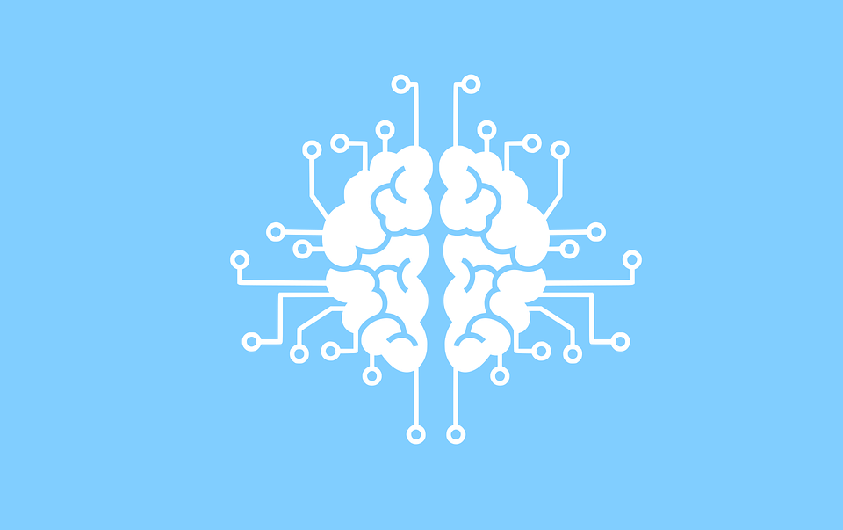
Neural Networks: A Primer
Adaptive Weights Mathematically Combined
Process:
Make a Guess
How bad is that Guess
Update in the correct direction
Deep Neural Networks:
Stacked blocks of Neural Network parts, making the pipeline more complex
Allows the model to learn more complex features

Slide 7
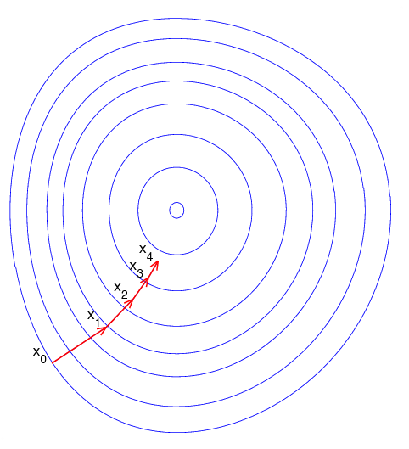
Optimizers: The Tool and Math to make Machines Learn
Gradient Descent:
Forward Pass: Input -> Output
Backward Pass: compute gradients
Make a step in the right direction
Stochastic Gradient Descent:
Batch Inputs to reduce Memory Consumption and time
“Noisy Steps”
Notes:
If this is too complex, luckily, TensorFlow and Keras simplifies all this math into a Python Library, simple for anyone to use and train networks.

Slide 8


Part Two: The TensorFlow + Keras Framework

Slide 9
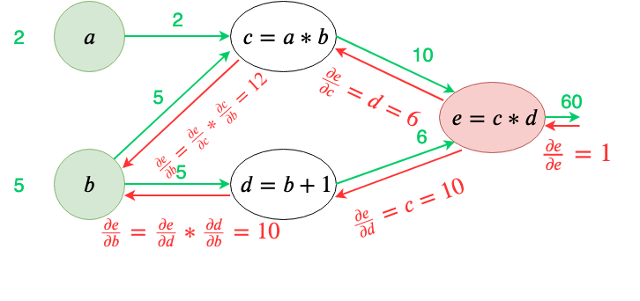
What is TensorFlow? (And Keras)
TensorFlow:
Graph Execution(Build a Computational Graph to train - Faster)
Eager Execution(Numpy with Differentiation)
Combine Mathematical Operations with differentiation quickly
Keras:
Layered Design, built on top of TensorFlow
Build Neural Networks with Ease by Abstracting away parts
Train models with little code using model.fit(Or custom loops)
Notes:
If this is too complex, luckily, TensorFlow and Keras simplifies all this math into a Python Library, simple for anyone to use and train networks.

Slide 10

TensorFlow Vs PyTorch: Pros and Cons
TensorFlow and PyTorch are different Python deep learning frameworks. I have worked with both of them:
TensorFlow:
Typically harder to debug, but can be heavily optimized(TPUs, Graph Execution)
Supported by Google
PyTorch:
Differentiable NumPy: even more so than TensorFlow
Easy to use for beginners, but slower due to mandatory Eager Execution
Analysis: Both can be(And are!) used to build amazing neural networks and publish new papers. You can achieve amazing results with both!

Slide 11
Interlude: Machine/Deep Learning Workflow
Step 5: Inference and Further Improvement
What did your model do well(Statistics and Quantitative Analysis)? What could be improved(Data, Model, etc.). Repeat the Cycle.
Step 1: What is the Problem?
Business Goals, Need, what are you trying to accomplish?
Deep Learning
Project
Step 4: Training Model
Optimizers, Training Loop, Number of Epochs, Hyper Parameter Tuning
Step 2: Data
Find Dataset(or more external data)
EDA(Exploratory Data Analysis)
Split Datasets into Train, Val, Test.
Step 3: Model
What is the Best model for the job?
CNN, RNN, MLP, Transformer?

Slide 12
TensorFlow and Keras Syntax and Best Practices

Slide 13
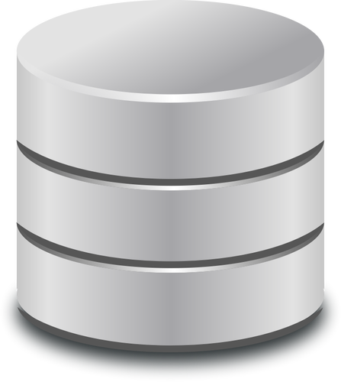
TF Data Pipeline: How Data is Processed:
TensorFlow runs Data Processing in “Graph-Like” manner. Data Preprocessing must be ran once first(on fake data to create the graph), then it is used in the pipeline.
Syntax:
tf.data: The main branch of data processing
tf.data.Dataset.from_tensor_slices: Easiest way to create a dataset
dataset.map: Create a function to add to the data graph
dataset.batch: Batch inputs
Dataset.repeat, dataset.shuffle: Repeat the dataset, shuffle it
Dataset.skip, Dataset.take: Skip or Grab data entries

Slide 14
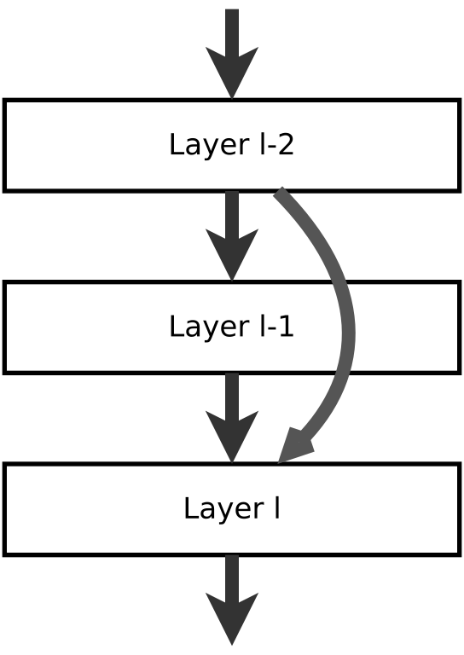
TF Model Creation with Keras:
Keras is an abstraction library that abstracts away the math of Deep Learning. Neural network creation is as simple as basic object-oriented programming:
Definitions:
keras.layers: a myriad of neural network layers
keras.Sequential: Simplest model, add layers in order
keras.layers.Layer: base class to inherit from to create a custom layer(Ex. Transformer Encoder, Squeeze-Excite Attention, your new novel layer!)
keras.Model: when building a subclassed model, use this to encapsulate the whole thing

Slide 15
Model Training with Keras
Operations on Models:
Model.call: run the model on an input
Model.compile: Compile the model(initialize weights) with keras metrics, loss functions, etc.
Model.fit: train the model on a tf.data.Dataset, everything is abstracted away, making this super simple
Model.evaluate: evaluate on a test set

Slide 16

Part Three: Interactive Colab Notebook:
Run the Notebook with me here(Link Also In Chat): https://colab.research.google.com/drive/1mu2FtD0TgHeJhJsc-AxzcyhuxRxciao4?authuser=2
Notes:
Introduce Jupyter and Colab
Run Through the Notebook Step by Step

Slide 17

What is the task?
Image Classification on CIFAR-10:
CIFAR 10 Dataset: 60000 images(Sized 32x32x3), sorted into 10 classes
Goals: to classify into the 10 classes with the highest accuracy possible
Use Cases of Image Classification:
Medical Classification, saving lives by diagnosing illnesses
Real-time classification system in the outside world
etc.

Slide 18

Dive into the Code!
Notes:
Introduce Jupyter and Colab
Run Through the Notebook Step by Step

Slide 19
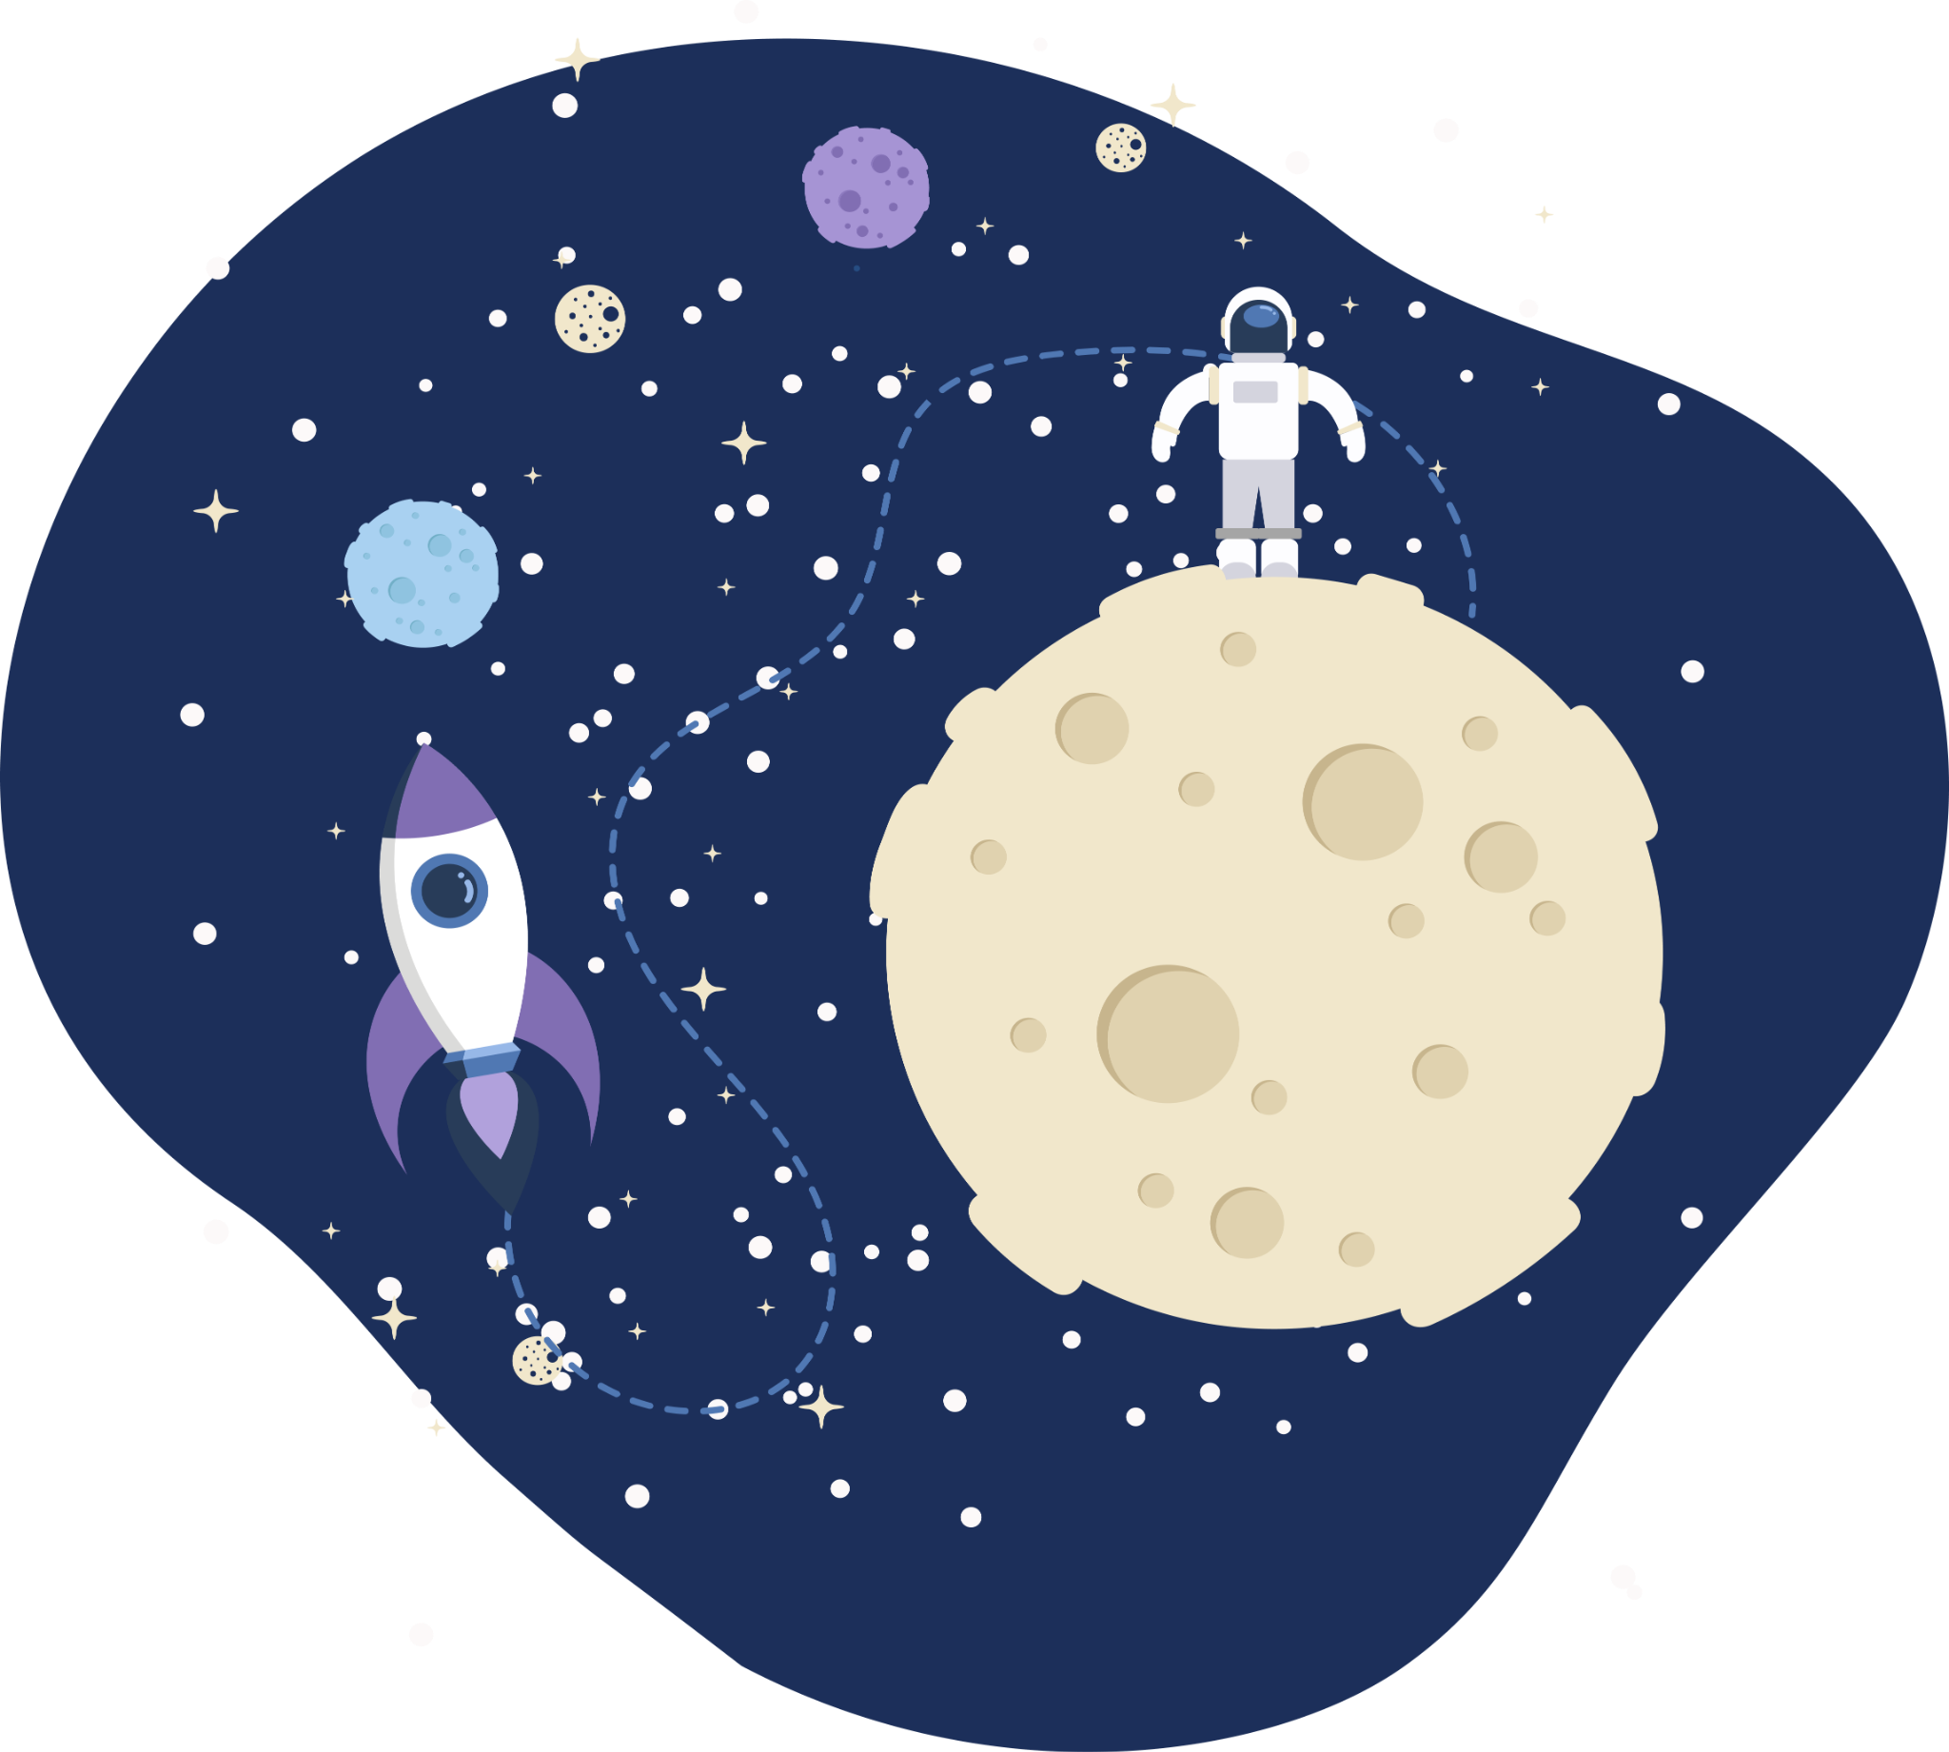
Thank you!
Any questions?

